Slide 1
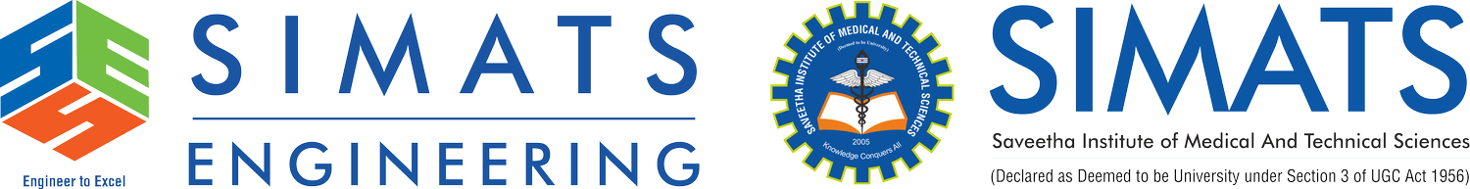
Cloud Migration Strategies: Moving Enterprise Applications to the Cloud
CSA1514 - CLOUD COMPUTING AND BIG DATA ANALYTICS
Guided By:
Dr.R.Latha
Presented By:
M.Balaji(192525059)

Slide 2


What is Cloud Migration?
Cloud migration means moving applications, data, and services from a local data center to the cloud.
Examples of cloud platforms are AWS, Microsoft Azure, and Google Cloud.
It helps companies use computing resources without maintaining their own hardware.
Cloud migration improves flexibility, scalability, and availability.
Simple Example:
A company moves its website and database from its own server to AWS.

Slide 3
Cloud Migration Strategies
There are 6 common strategies:
Rehost: Move the application without major changes.
Replatform: Move it with small improvements.
Refactor: Redesign the application for the cloud.
Repurchase: Replace old software with cloud software.
Retain: Keep the application on the existing system.
Retire: Remove applications that are no longer needed.
Most common: Rehost, Replatform, and Refactor.

Slide 4
Architecture, Benefits & Challenges
Architecture
Users → Load Balancer → Cloud Application → Database
Benefits
Lower infrastructure cost
Easy scalability
Faster deployment
High availability
Challenges
Data security
Downtime during migration
Compatibility problems
Cloud cost management

Slide 5
Advantages of Cloud Migration
Cost Saving – Reduces hardware and maintenance costs.
Scalability – Resources can be increased or decreased easily.
High Availability – Applications can remain available with less downtime.
Flexibility – Users can access applications from anywhere.
Faster Deployment – New applications and services can be deployed quickly.
Backup & Recovery – Cloud provides easy backup and disaster recovery.

Slide 6
Disadvantages of Cloud Migration
Security Risks – Sensitive data must be properly protected.
Migration Downtime – Applications may experience downtime during migration.
Internet Dependency – Cloud services require a reliable internet connection.
Migration Cost – Initial migration can be expensive.
Compatibility Issues – Older applications may not work directly in the cloud.
Vendor Lock-in – Moving from one cloud provider to another can be difficult.

Slide 7
Case Study: Netflix
Netflix Cloud Migration
Netflix moved from traditional data centers toward AWS cloud infrastructure.
Cloud helped Netflix handle a large number of users.
It uses distributed cloud services for better scalability and reliability.
Cloud infrastructure allows resources to be increased when demand is high.
Netflix also uses automation and monitoring to maintain its services.
Key Lesson:
A well-planned cloud migration can provide scalability, reliability, and better performance.

Slide 8
Conclusion
Cloud migration moves enterprise applications and data to cloud platforms.
Companies can choose different strategies based on their requirements.
Proper planning, security, testing, and monitoring are important.
Cloud provides scalability, flexibility, availability, and cost benefits.
Successful migration helps organizations build modern and efficient IT systems.

Slide 9


